Slide 1
Tic-Tac Game
Prepared by Kafr El-Sheikh team
Marwa Mohammed
Safeya Mohamed

Slide 2
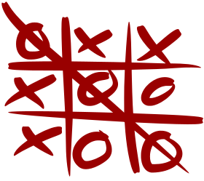
The goal of Tic -Tac -Toe is to be one of the players to get three same symbols in a row - horizontally, vertically or diagonally - on a 3 x 3 grid.

Slide 3
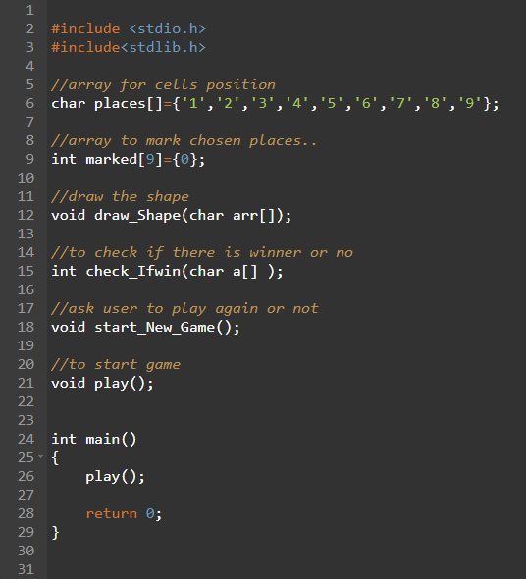
Function
draw_Shape(): This function draw the main shape of game.
play(): To start the game.
check_Ifwin(): To check there is a winner or not.
star_New_Game(): If the user want to play another game after win or a tie.

Slide 4
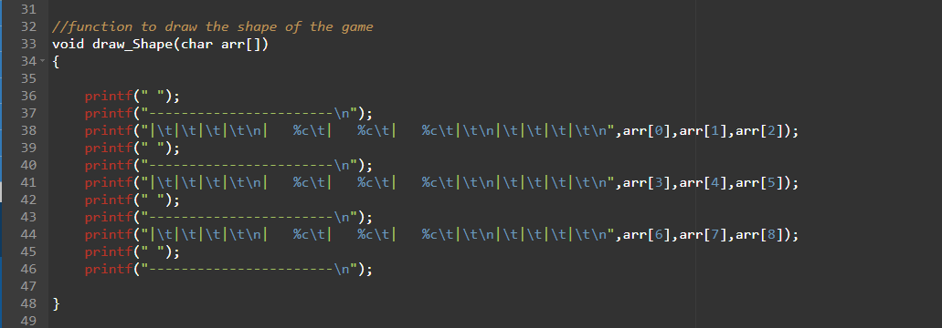
Draw-shape function

Slide 5
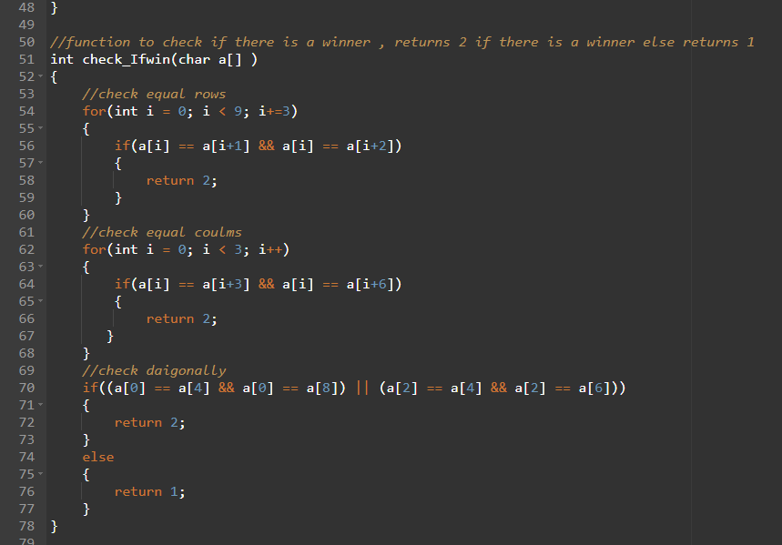
Check-If-win function
The player can win if
Get three same symbol in the first row or second or third
Get three same symbol in the first column or second or third
Get three same symbol in main diameter or secondary diameter

Slide 6
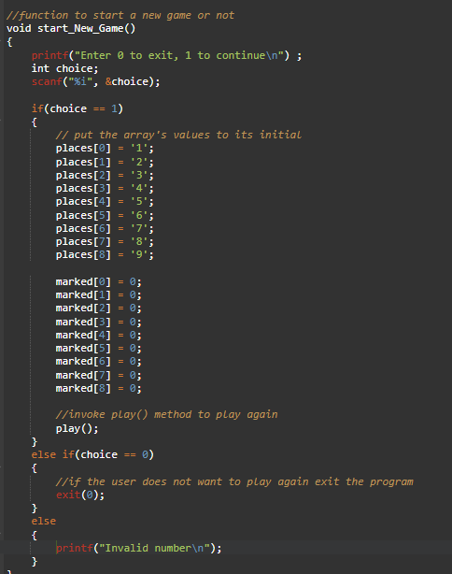
Start-New-Game function
If the game ended with winner or tie the user can play again with enter number one or to exit from game

Slide 7
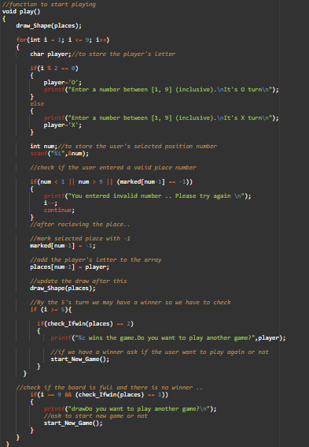
Play function
To start the game
The user will choose number from one to nine and every number he choose will replace it by x or o depend on how’s turn
Every number will chosen will book it by -1 by array of marked until be chosen again

Slide 8
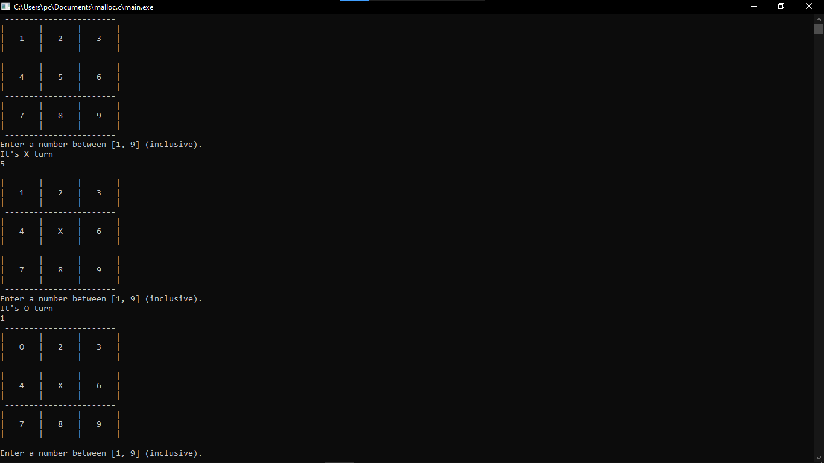
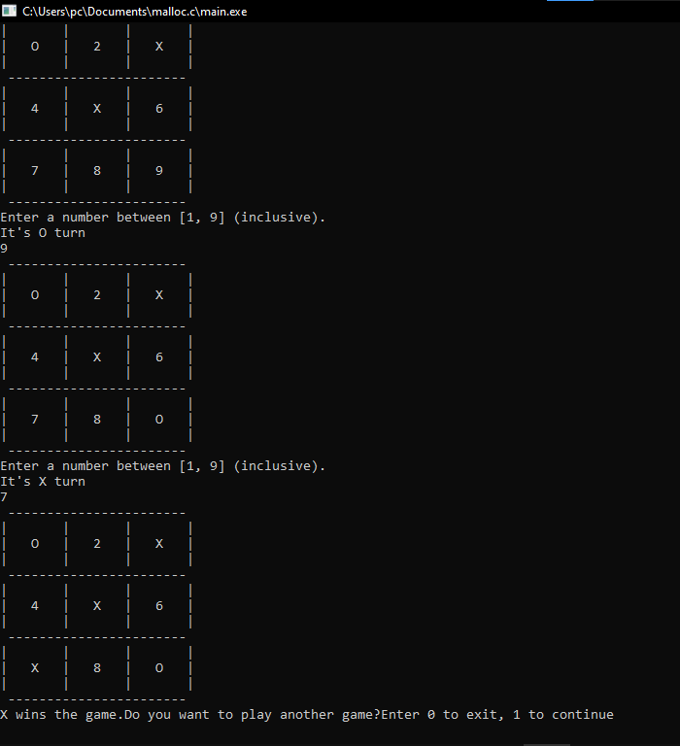

Slide 9
